Slide 1
Digital Portfolio
STUDENT NAME: Naveen Kumar.s
REGISTER NO AND NMID: 2422, 01848@sbru17242210184
DEPARTMENT:
College: sri vasavi college self finance wings Bharathiya Buniversity/UNIVERSITY

Slide 2
PROJECT TITLE
My Bio Data

Slide 3


AGENDA
Problem Statement
Project Overview
End Users
Tools and Technologies
Portfolio design and Layout
Features and Functionality
Results and Screenshots
Conclusion
Github Link
3/21/2024 Annual Review

Slide 4

PROBLEM STATEMENT
Nowadays, students and professionals often face difficulties in presenting their biodata in a clear and attractive way. Traditional paper biodata or resumes are limited, easily misplaced, and do not highlight skills interactively. A biodata website solves this problem by providing a digital platform to showcase personal information, education, skills, and achievements in an organized and accessible manner. It allows others, such as employers, teachers, or friends, to easily view and understand

Slide 5

PROJECT OVERVIEW
Creating Web page in digital portfolio to bio data. Using the language HTML CSS JavaScript

Slide 6

WHO ARE THE END USERS?
6 Edit on PC All the user and humans are the end user.

Slide 7

TOOLS AND TECHNIQUES
Digital portfolio visual basic stdio Code pee HTML CSS Javascript 7

Slide 8
POTFOLIO DESIGN AND LAYOUT
8

Slide 9
FEATURES AND FUNCTIONALITY
Features of Biodata Website User-friendly Interface Simple and clean design for easy navigation. Personal Information Section - Displays name, photo, contact details, etc. Features of Biodata Website Facilities of Biodata Website Provides a digital platform for presenting biodata. Accessible anytime, anywhere via the internet.

Slide 10
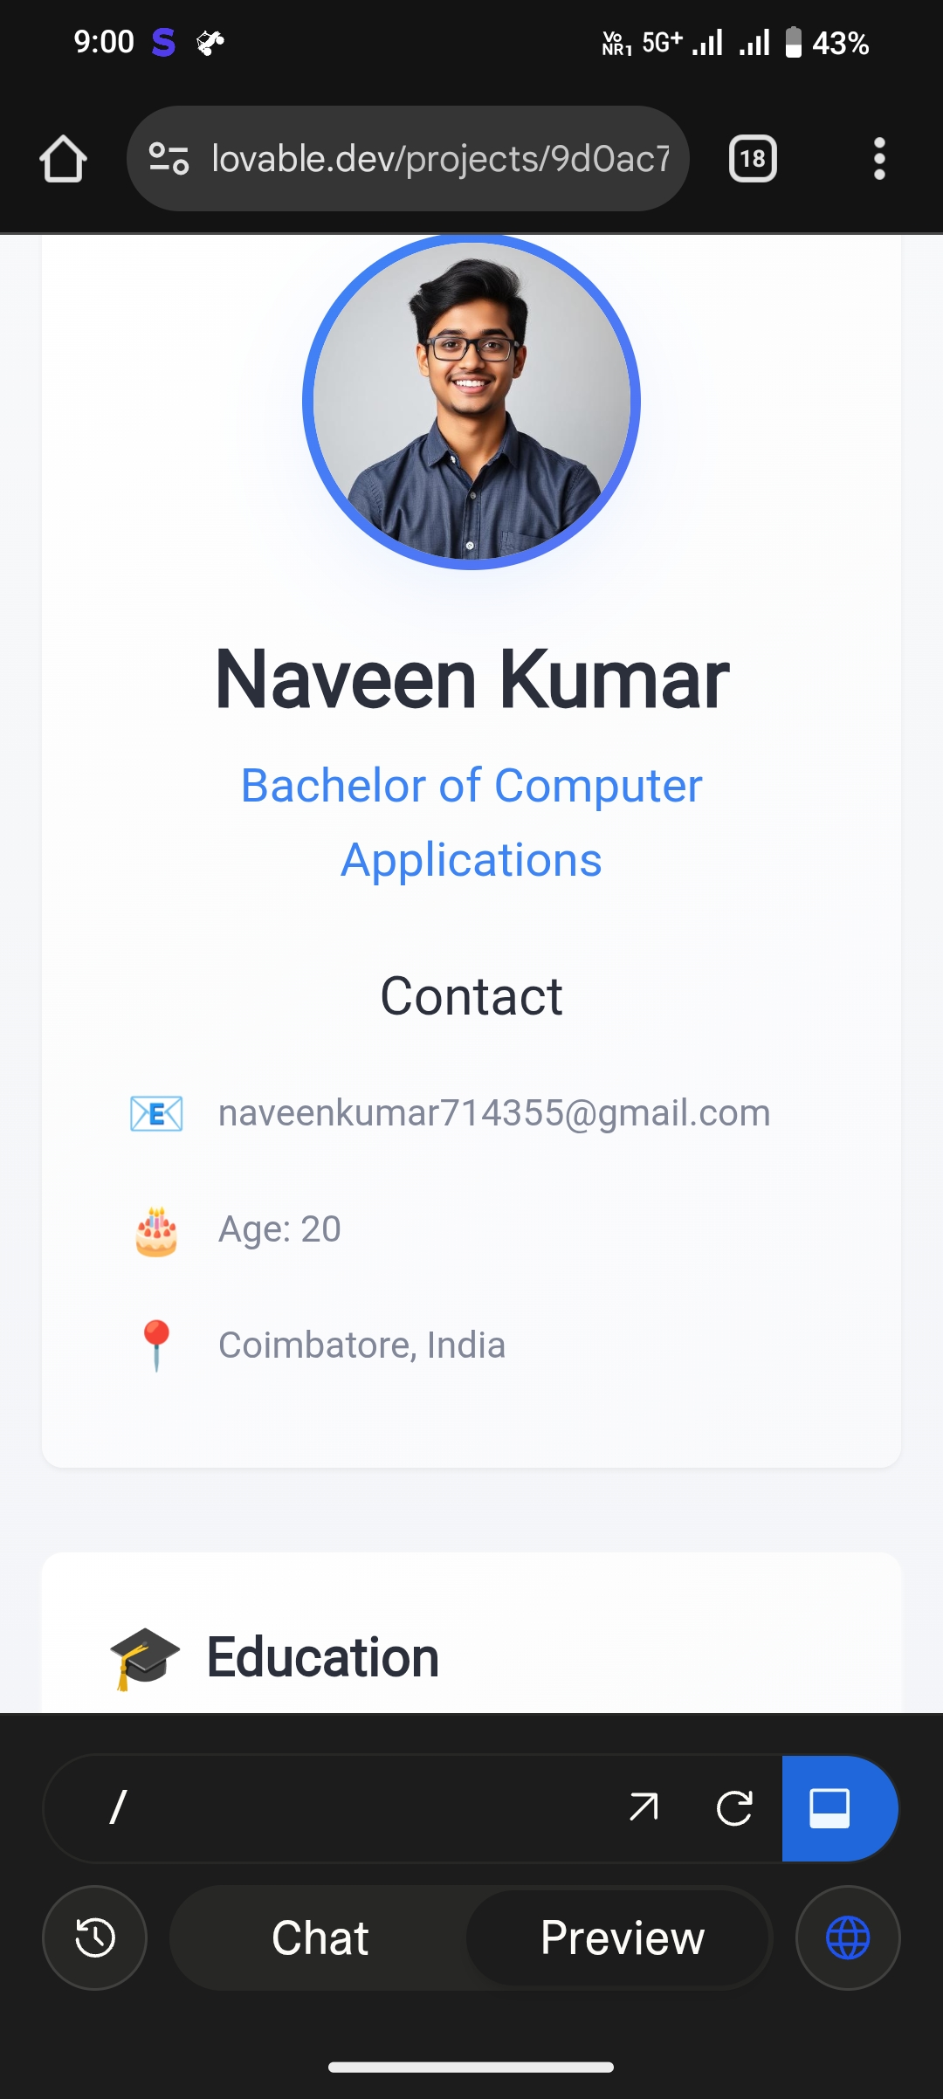

RESULTS AND SCREENSHOTS
3/21/2024 Annual Review
10

Slide 11
CONCLUSION
conclusion, the biodata website provides a simple and effective platform to present personal, educational, and professional details in a well-organized manner. It eliminates the limitations of traditional paper resumes and makes information accessible anywhere, anytime. By showcasing skills, achievements, and contact details digitally, the website not only
11

